Slide 1
PVWatts
SAPM
Extract characteristic module values from PAN File
Import module dictionary using retrieve_sam or measured coefficients
Use pvsystem_sapm function to calculate string DC power
Use pvwatts_dc function to calculate string DC power
Extract characteristic module values from specification sheet
CEC/Desoto
Extract characteristic module values from PAN File
Use fit_cec_sam function to generate the input parameters
Use calcparams_cec/ desoto function to generate the single diode model input parameters
Use singlediode function to calculate string DC power
Extract characteristic module values from specification sheet

Slide 2
61853 Matrix Models
Import matrix of 61853 test data
Use fit_efficiency_model to generate optimized values
Use model function to calculate efficiency
Convert normalized efficiency to DC power
PVSyst
Extract characteristic module values from PAN File
Calculate photocurrent & diode reverse saturation current @ STC
Use fit_cec_sam function to generate the input parameters
Use calcparams_cec/ desoto function to generate the single diode model input parameters
Use singlediode function to calculate string DC power
Extract characteristic module values from specification sheet
Calculate photocurrent & diode reverse saturation current @ STC, diode ideality factor, and shunt resistance at 0 irradiance

Slide 3
Model | Sandia Array Performance Model (SAPM) | PVWatts | Single Diode Models (CEC, Desoto, PVSyst) | Matrix Models (ADR, Heydenreich, MotherPV, PVGIS, MPM5, MPM6, Bilinear)
Input Parameters
Effective Irradiance¹ | ✔ | ✔ | ✔ | ✔
Measured Module Temp | ✔² | ✔² | ✔² | ✔
SAPM Coefficients | ✔
STC Power & Temperature Coefficient |  | ✔
PAN File Coefficients |  |  | ✔
61853 Matrix Data |  |  |  | ✔
Output Values
Isc | ✔ |  | ✔
Imp | ✔ |  | ✔
Vmp | ✔ |  | ✔
Voc | ✔ |  | ✔
Pmp | ✔ | ✔ | ✔
Normalized Efficiency |  |  |  | ✔
¹Calcualted using sapm_effective_irradiance which considers direct POA, diffuse POA, absolute airmass, and angle of incidence
²These modules use cell temperature, which is calculated from module temperature using pvlib.temperature.sapm_cell_from_module

Slide 4
Manufacturer & Model | Cell Technology | # of Modules | Installation Date
LG 320N1K-A5 | N-PERT Si | 4 strings of 12 (48) | June 2018
Panasonic VBHN325SA16 | HIT Mono | 4 strings of 12 (48) | June 2018
Canadian Solar CS6K-270P | Poly-Si | 4 strings of 12 (48) | October 2017
Canadian Solar CS6K-275M | Mono-Si | 4 strings of 12 (48) | October 2017
Hanwha Q Cells Plus Q.Plus BFR-G4.1 280 | Poly-Si PERC | 4 strings of 12 (48) | October 2017
Hanwha Q Cells Peak Q.Peak BFR-G4.1 290 | Mono-Si PERC | 4 strings of 12 (48) | October 2017
Mission Solar MSE300SQ5T | Mono-Si PERC | 4 strings of 12 (48) | May 2019
Jinko Solar JKM260P-60 | Poly-Si | 4 strings of 12 (48) | April 2020*
Itek Energy IT-360-SE72 | Mono-Si PERC | 5 strings of 10 (50) | March 2020
*The Jinko system was initially installed in June 2016 but was later moved to the current configuration at the given date

Slide 5
Raw Data from Weather Station
Filter Parameter | Lower Bound | Upper Bound
Solar Elevation | 15 deg | 90 deg
Effective Irradiance | 50 W/m² | 1200 W/m²
Cell Temperature | -40 ºC | 85 ºC
Module Temperature | -40 ºC | 85 ºC
Ambient Temperature | -10 ºC | 40 ºC
Current vs Irradiance | 70% of slope of I_{mp}/G_{eff} | 130% of slope of I_{mp}/G_{eff}
Solar Elevation
xx.xx% Remaining
Effective Irradiance
xx.xx% Remaining
Cell & Module Temperature
xx.xx% Remaining
Ambient Temperature
xx.xx% Remaining
I_{mp}/G_{eff}
xx.xx% Remaining

Slide 6
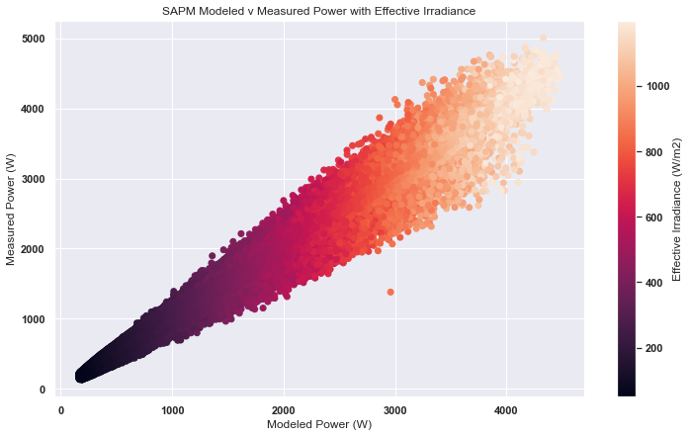
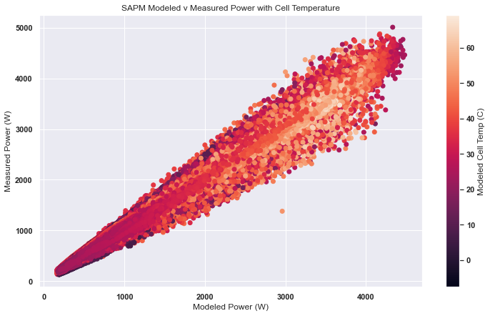
Notes:
Modeled vs Measured power for SAPM model for LG System with temperature & irradiance as color

Slide 7
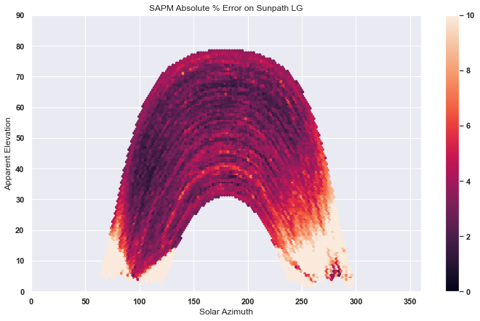
Notes:
SAPM mean absolute percent error on sunpath as color for LG System

Slide 8
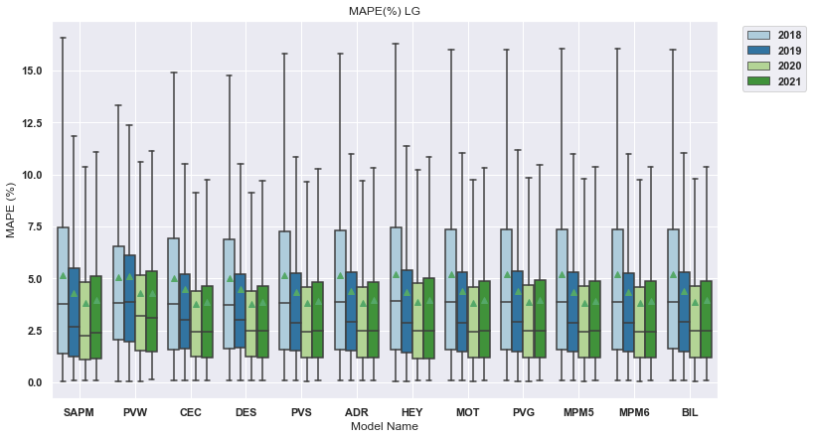
Notes:
MAPE for individual LG System, can also be displayed as years on x and models as hue

Slide 9
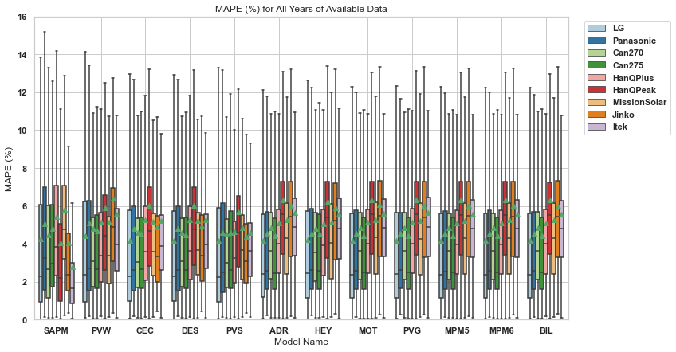

Slide 10
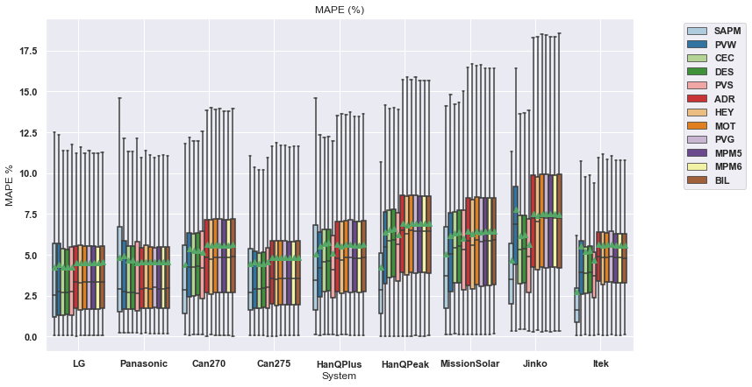
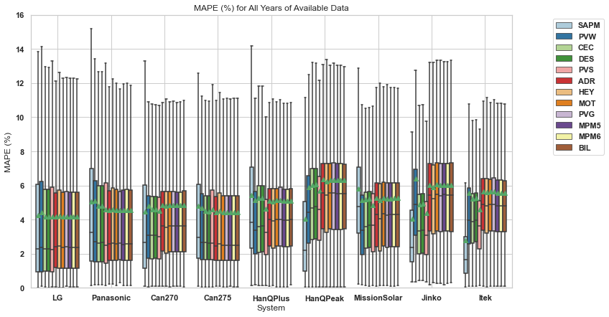

Slide 11
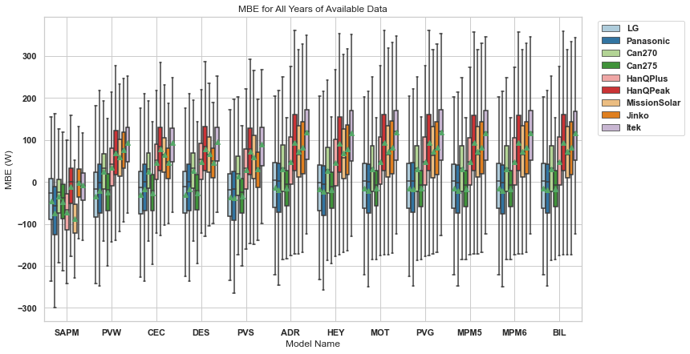
Notes:
MBE for all systems & all models & all years, can also be displayed with models on x axis and systems as hue (next slide)

Slide 12
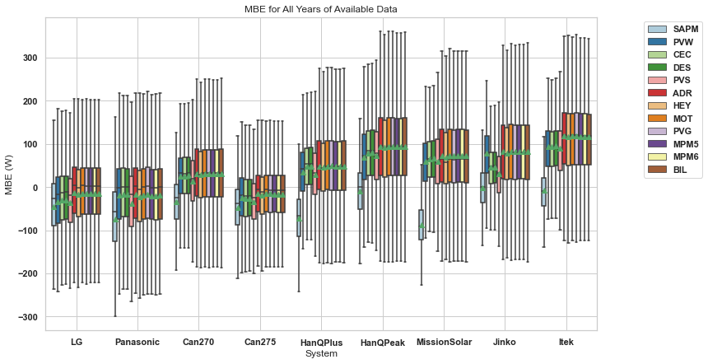

Slide 13
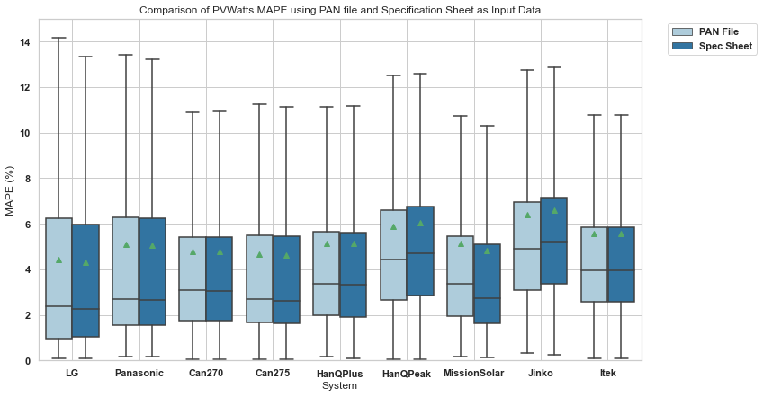

Slide 14
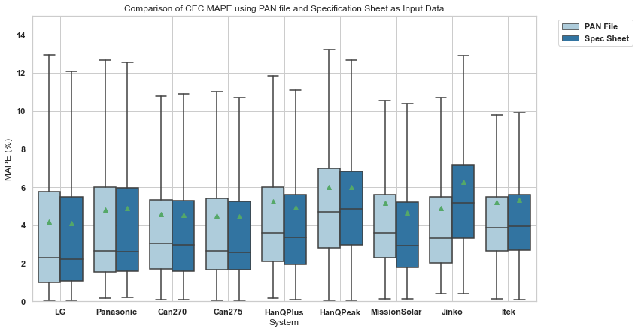

Slide 15
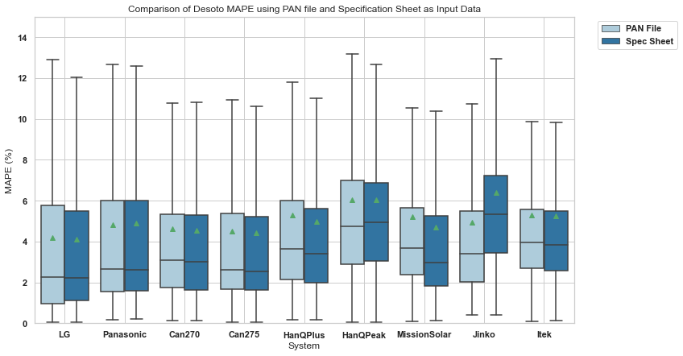
Desoto

Slide 16
